Slide 1
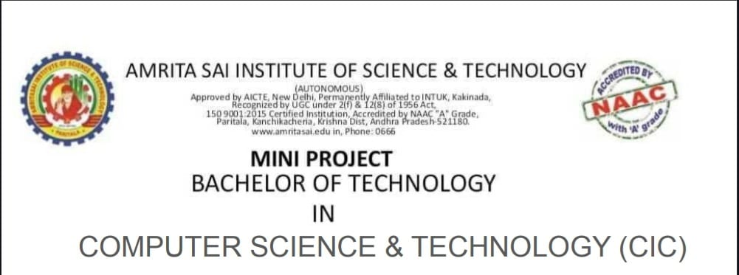
PROJECT NAME:
NAME:N.NAVYA
REG NO:22AJ1A4736

Slide 2
WHEATHER APP
NAME:N.NAVYA
REG NO:22AJ1A4736
BRANCH:CIC

Slide 3
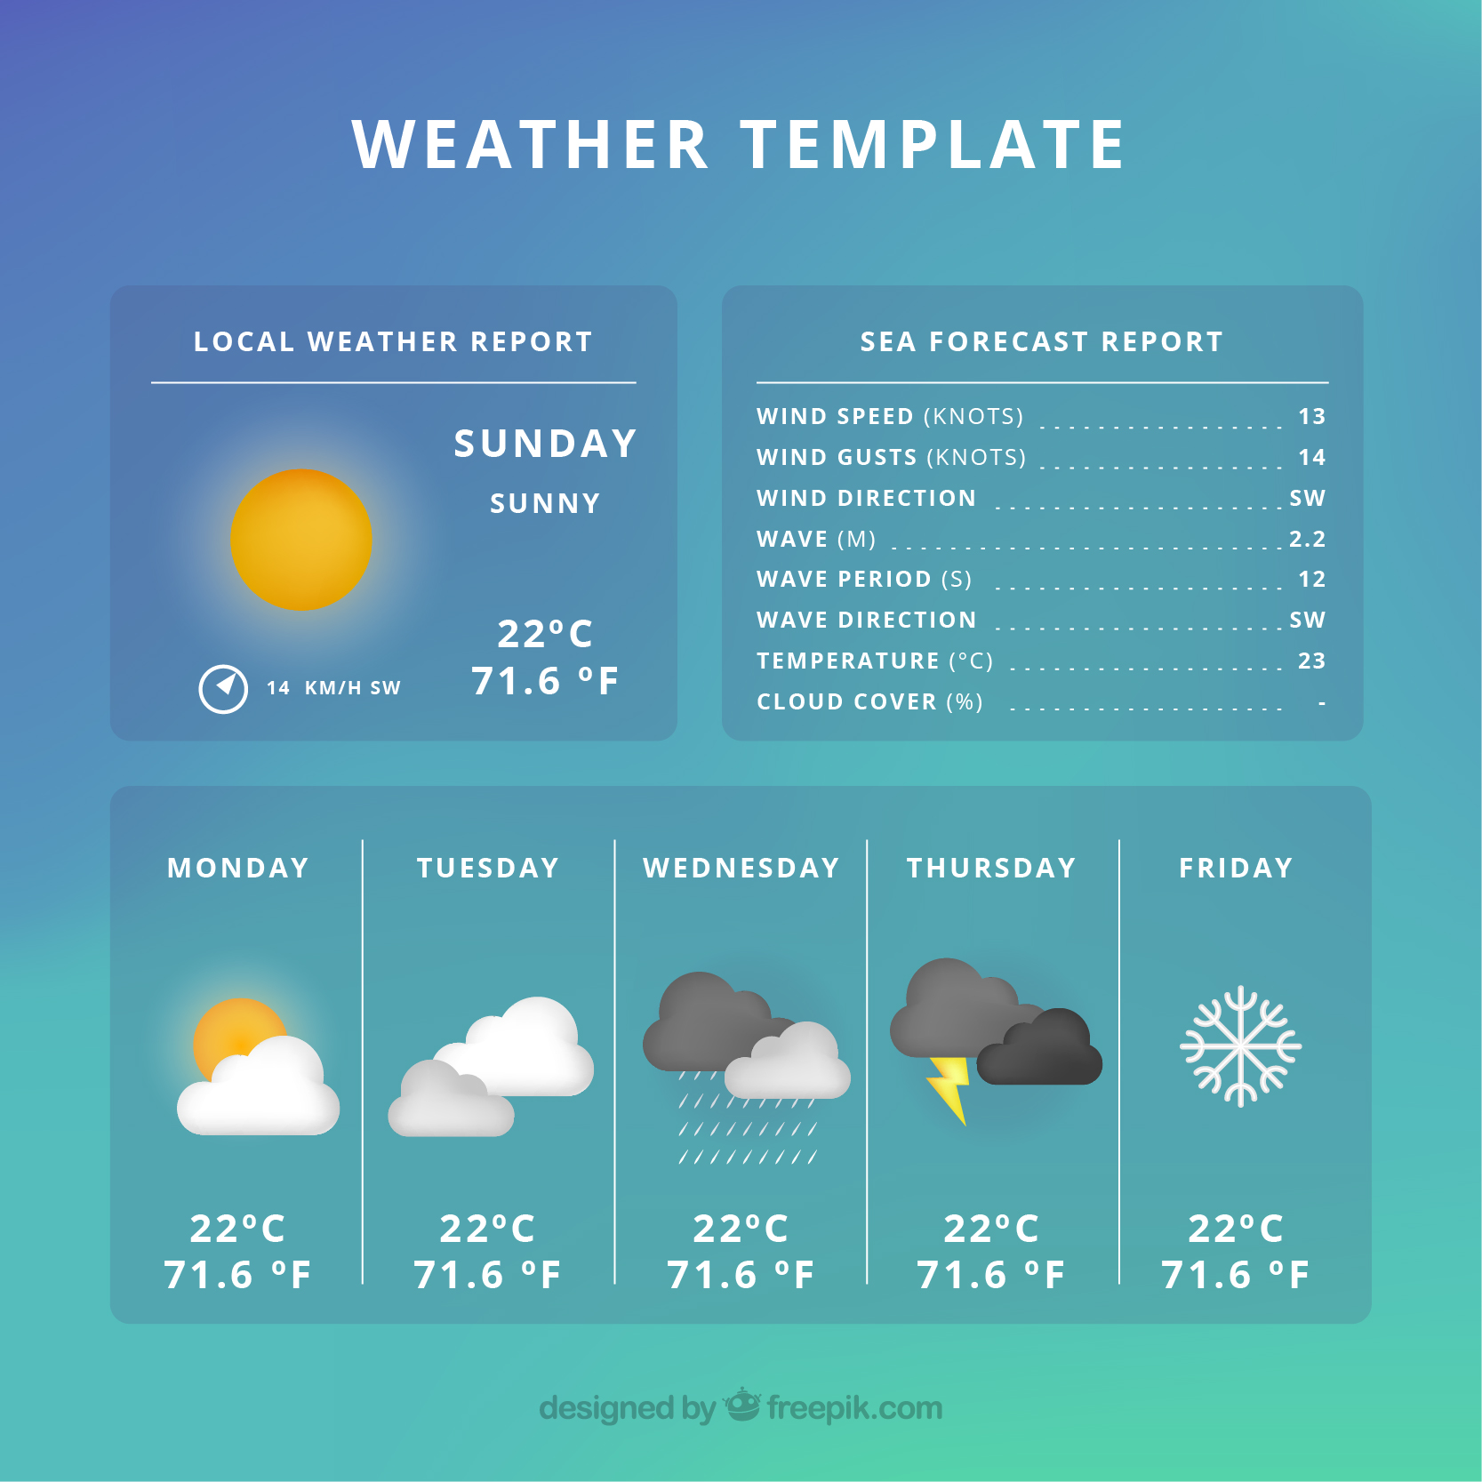
Whether App:
Get real-time, accurate weather forecasts, detailed radar maps, and severe weather alerts. Plan your day with hourly, daily, and 7-day forecasts. Track temperature, humidity, wind speed, and precipitation for any location. Personalize your experience with weather notifications and save your favorite locations for quick updates. Whether it’s rain, shine, or storm, you’ll always be prepared with reliable information at your fingertips!

Slide 4

Stack Used:
Wheather app
Overview: wheather app is an online Web For measuring Atmosphere. It supports HTML, CSS, and JavaScript, allowing users to create
Features: Get live weather conditions for your current location or any place worldwide, including temperature, humidity, wind speed, and visibility.
Limitations : Weather predictions can sometimes be inaccurate, particularly for long-term forecasts. Sudden weather changes may not be captured.

Slide 5
SOFTWARE REQUIREMENTS
.Frontend Technologies:
HTML/CSS: For structuring and styling the editor's user interface.
JavaScript: For implementing interactive features and real-time updates.
Frameworks/Libraries: For Advanced Compnents And Specified Features Used Bootstrap and Tailwind Css
API : Fore Cast Api Has Been Used

Slide 6
HARDWARE REQUIREMENTS:
Server Specifications:
Processor: Multi-core processors (e.g., Intel Xeon or AMD EPYC) for handling multiple concurrent users.
Memory: Minimum 16GB RAM, scalable based on user load and application complexity.
Storage: SSDs with sufficient capacity to store user data, code snippets, and application logs.
Network: High-speed internet connectivity with load balancing and failover capabilities to ensure uptime and reliability.

Slide 7
ADVANTAGES
Advantages:
Real-Time Updates: Access immediate weather conditions and forecasts, allowing for informed decision-making.
Severe Weather Alerts: Receive timely notifications about severe weather events to help ensure safety
. User-Friendly Interface: Intuitive design makes it easy to navigate and find relevant weather information quickly.
Multiple Location Tracking: Save and monitor weather conditions for multiple locations, ideal for travelers or those with loved ones in different areas.
Interactive Maps: Visualize weather patterns and storm tracks through dynamic radar maps for better planning and awareness.

Slide 8
DISADVANTAGES
Accuracy Issues: Weather predictions can sometimes be unreliable, especially for long-term forecasts or sudden weather changes
Data Connectivity Required: Many apps require an internet connection for real-time updates, limiting usability in areas with poor connectivity.
Overwhelming Information: Users may find the abundance of data and technical jargon confusing or overwhelming.
Privacy Concerns: Sharing location data for personalized forecasts may raise privacy concerns among users.

Slide 9
CONCLUSION
In conclusion, weather apps serve as essential tools for navigating daily life and staying informed about weather conditions. Their real-time updates, severe weather alerts, and user-friendly interfaces empower individuals to make informed decisions about outdoor activities, travel, and safety. While they offer numerous advantages, including personalized notifications and interactive maps, users should also be aware of their limitations, such as potential accuracy issues and privacy concerns. Overall, with continuous improvements in technology and data accuracy, weather apps remain valuable resources for anyone looking to stay ahead of the weather.

Slide 10
THANK YOU

